Slide 1
RFID: Collision Avoidance
NC 812/ESD 812

Slide 2
Reading the Tags
The tags typically derive their energy for operation and data transmission from a reader’s electromagnetic field.
The reader recognizes tagged objects through a wireless channel in which each tag transmits its unique ID and other information.
Tag reading throughput is critical while scanning tagged items in a large-scale RFID application. Two main performance criteria are used to measure the throughput,
tag reading delay
the energy consumption of RF reader

Slide 3
Collision
The reader and the tags communicate over a shared wireless channel. If more than two tags respond to the reader simultaneously, the signals transmitted by these tags collide with each other.
Due to the signal collisions, either the reader cannot recognize tags (or tagged objects) or a retransmission request for tags’ IDs is required, and increasing the communication overhead and identification delay.
Collision occurs when either several tags or several readers are simultaneously present in the same field. Tag collision occurs when a reader attempts to simultaneously read several tags. Reader collision occurs when two or more readers are simultaneously present in the same field.

Slide 4
Singulation
To reduce the number of collisions, Reader Talk First (RTF) protocols have been used.
Singulation is the process that a reader performs to identify and/or communicate with a particular tag in the presence of multiple tags that are in range of the reader.
An anti-collision protocol is the protocol used to prevent two or more devices from interfering with each other in a common communication channel to share the medium. They are also called medium access control (MAC) protocols.

Slide 5
Collision Avoidance
Collision avoidance techniques for tags are mainly classified into two types:
(a) probabilistic, and
(b) deterministic.
Reader based collision avoidance protocols are mainly classified into four types:
(a) Polling based protocol
(b) Splitting method based protocol
(c) I-code protocol and
(d) Contact less protocol.

Slide 6
Options
Space Division Multiple Access (SDMA) Technique: Categorize channel into separate areas.
Minimize the reading range of reader.
Use electronically controlled directional antenna.
Distinguish tags based on their angular positions.
Time Division Multiple Access (TDMA) Technique: allocates the available channel bandwidth to readers and tags with respect to time.
Based on the time allocated, tags respond in their time slots.
Reader talks first, tags listen. Later tags respond to the reader based on the time allocated.

Slide 7
Options
Frequency Division Multiple Access (FDMA) Technique:
the channel bandwidth is split into smaller bandwidths dedicated to individual tags until the communication among the tag and the reader is completed.
Code Division Multiple Access (CDMA) Technique:
Readers are identified by their unique codes and works in synchronization with each other.
Too complicated for RFID system due to the computation time required.

Slide 8
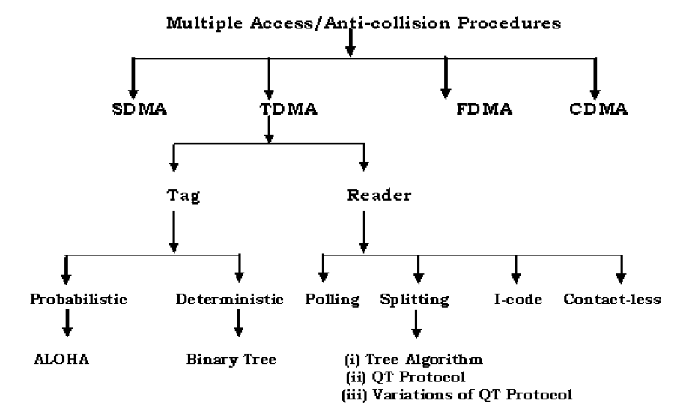
Techniques

Slide 9
Tags
The collision avoidance protocols of the tags are mainly classified into two types.
(a) Probabilistic and
(b) Deterministic.
All probabilistic protocols are basically enhanced versions of ALOHA protocol.
The main aim of these algorithms is to decrease the probability of collisions since all the tags try to respond in different intervals of time.

Slide 10
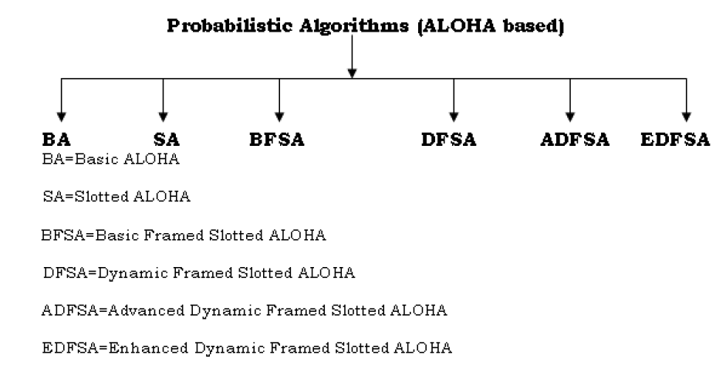
Probabilistic Algorithms

Slide 11
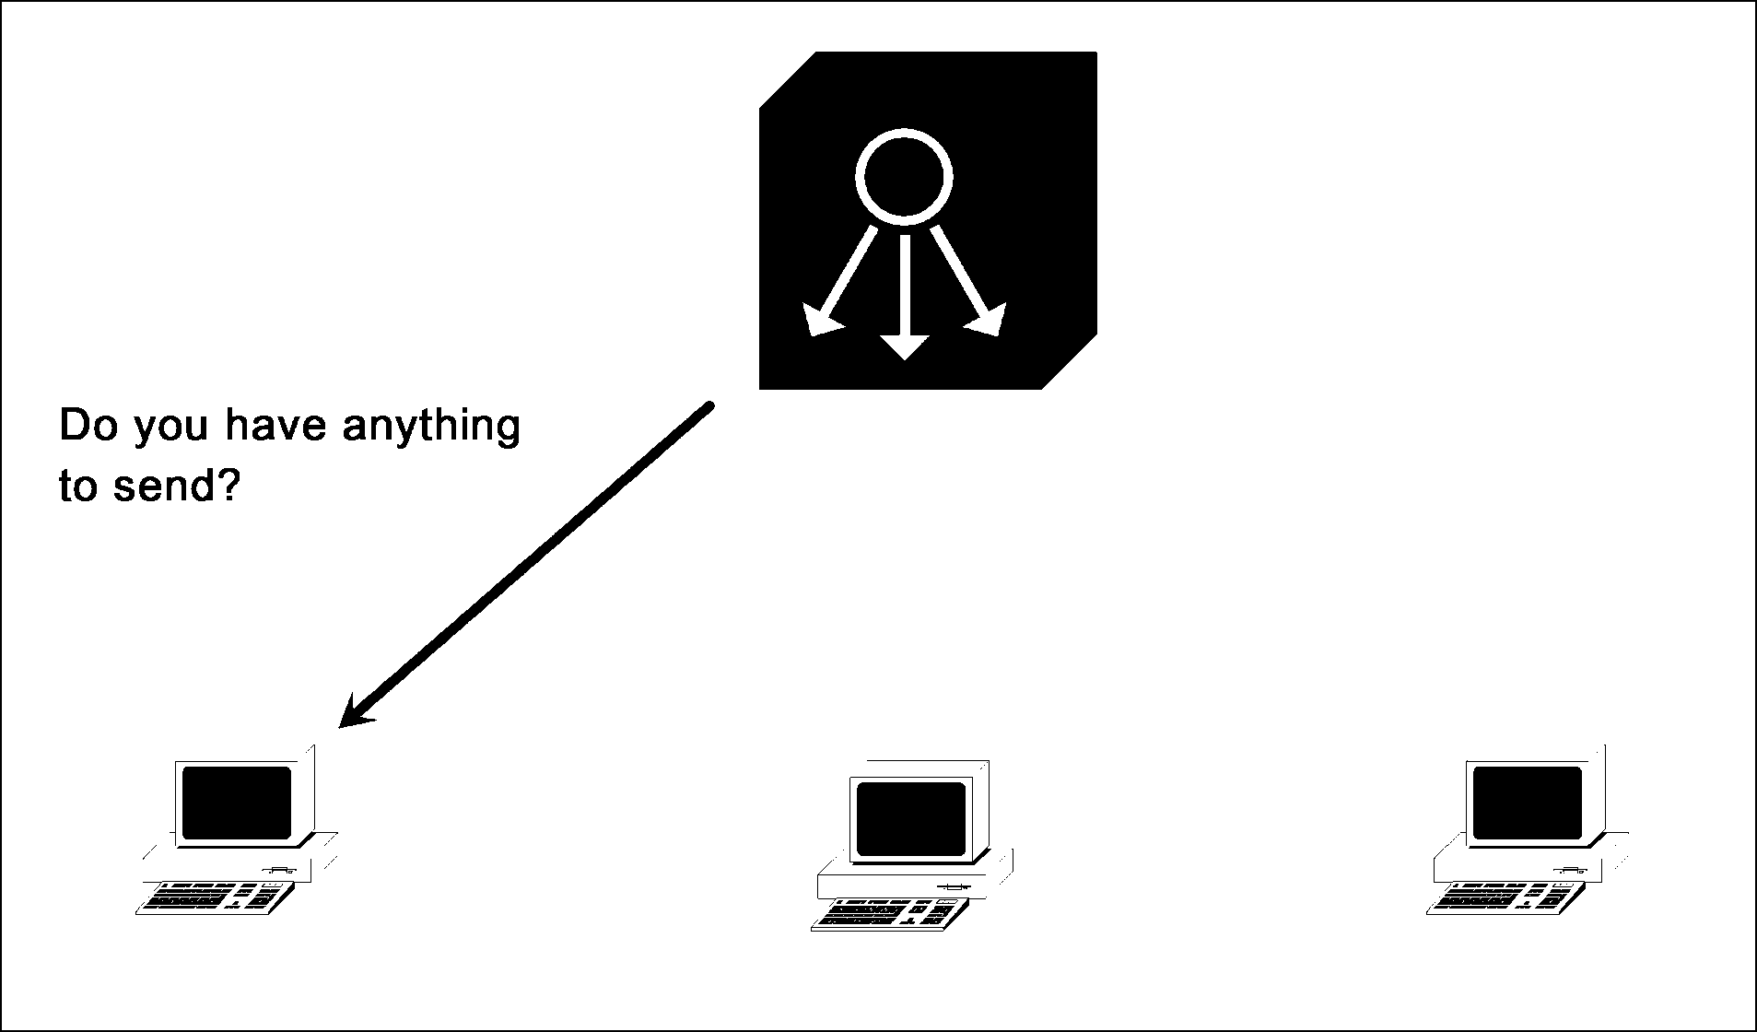
Polling

Slide 12
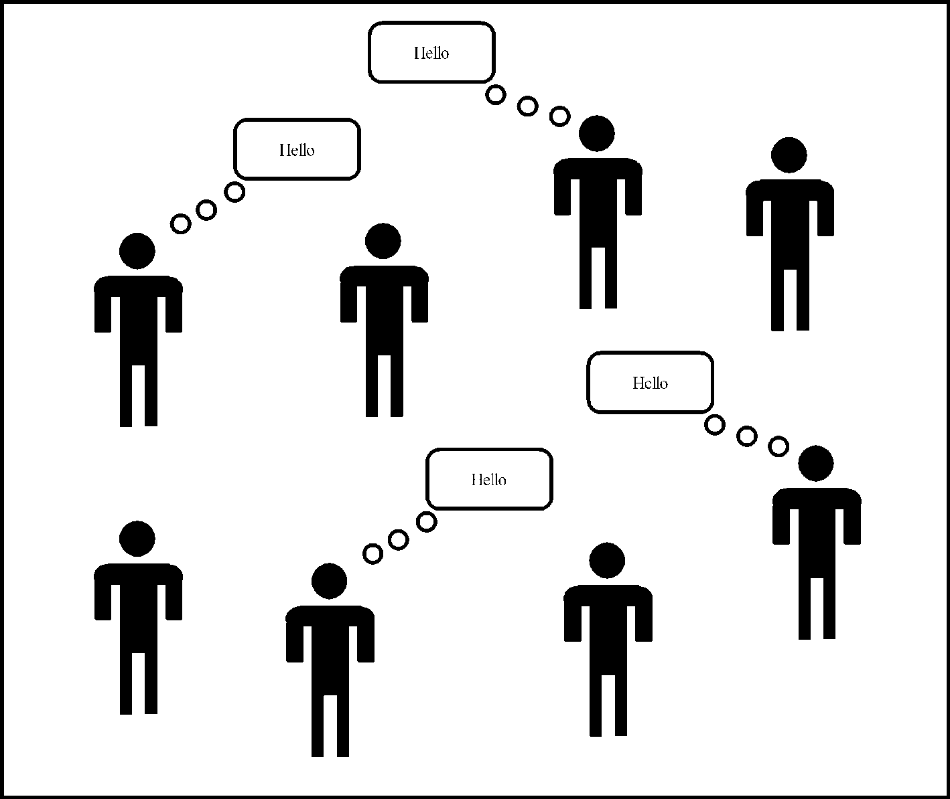
Random access

Slide 13
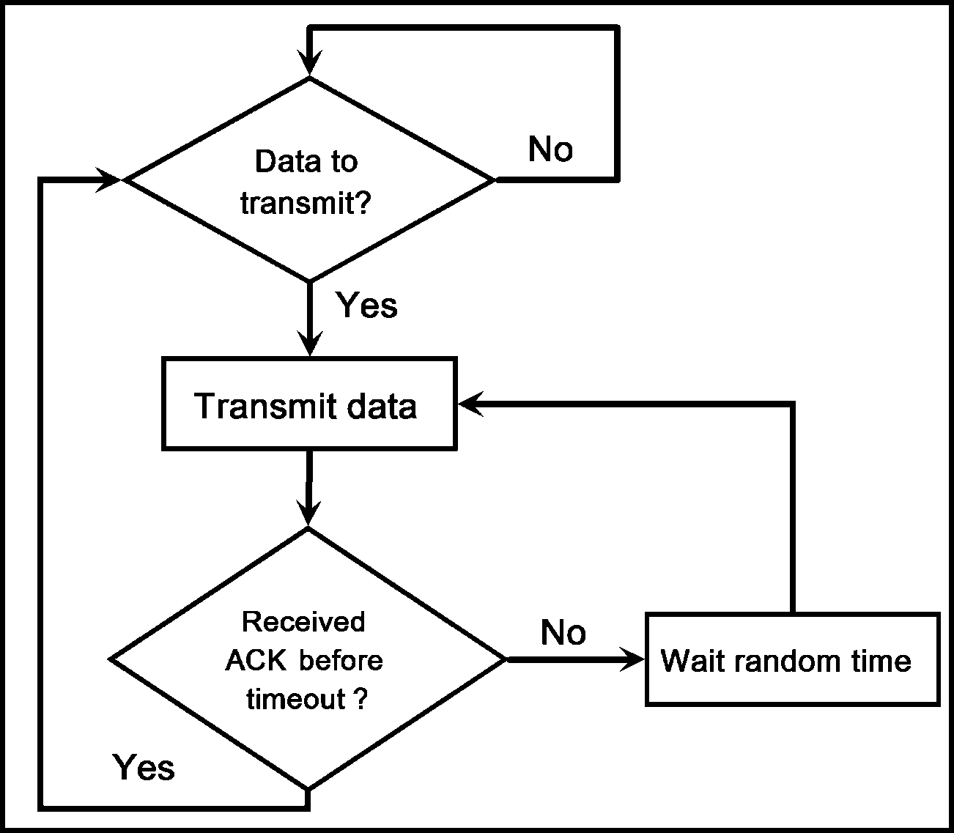
Pure Aloha

Slide 14
Pure Aloha
In pure Aloha, the tags-reader engagement is random. Tags send their packets randomly when electromagnetically activated by the reader. Collision of packets is inevitable, when two or more tags try to transmit their data packets at the same time.
The efficiency of this algorithm will drop down if there is a large tag density in the vicinity of the reader or if the tags have large amount of data. One possibility for optimizing the performance of the ALOHA algorithm is the slotted ALOHA algorithm.

Slide 15
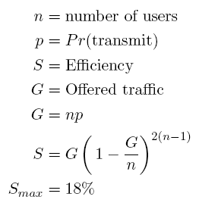
Pure Aloha Efficiency

Slide 16
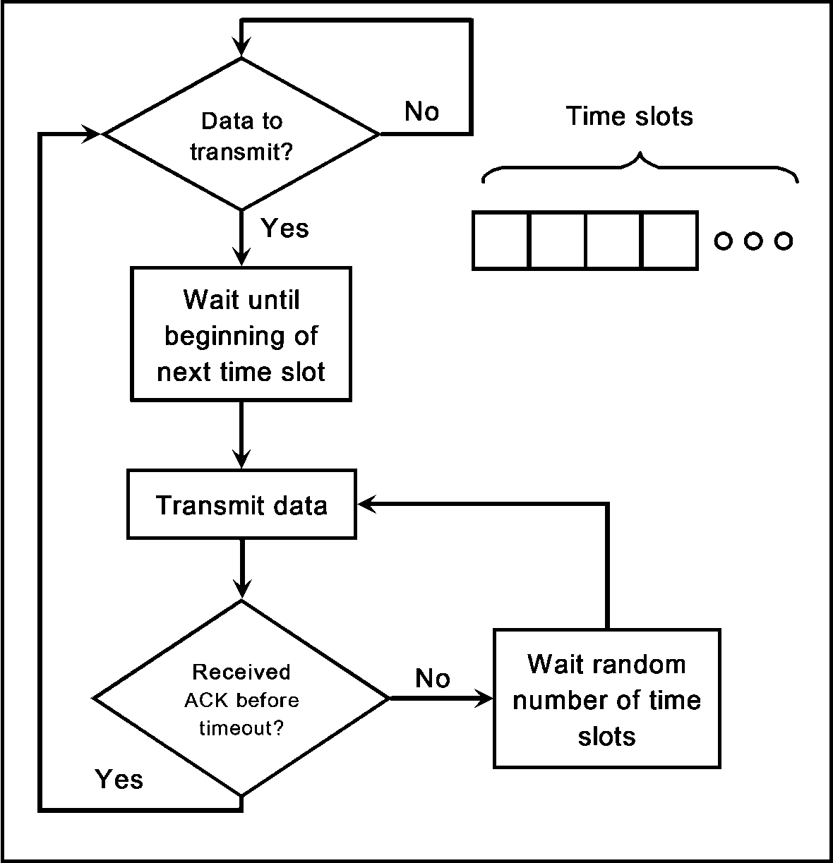
Slotted Aloha

Slide 17
Slotted Aloha
In slotted ALOHA the available time is further divided into distinct time intervals called time slots and a tag is permitted to transmit at the beginning of a slot.
Collision of the tags will be either complete or not at all.
No chances of partial collisions like in the pure ALOHA case.
Can be called as a reader-driven TDMA anti-collision Protocol.
It has better performance than the basic ALOHA because of the synchronization between the reader and the tags.

Slide 18
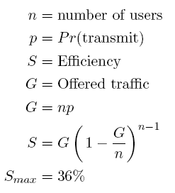
Slotted Aloha Efficiency

Slide 19
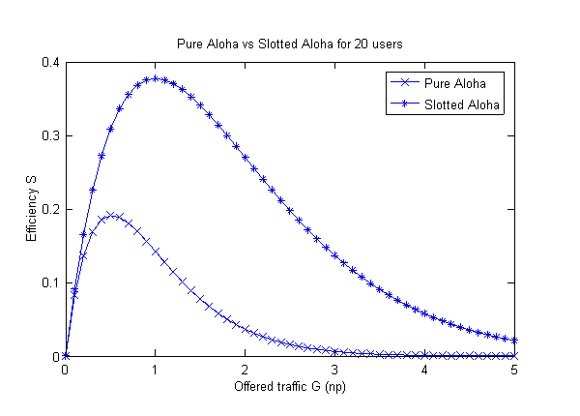
Pure Aloha vs Slotted Aloha

Slide 20
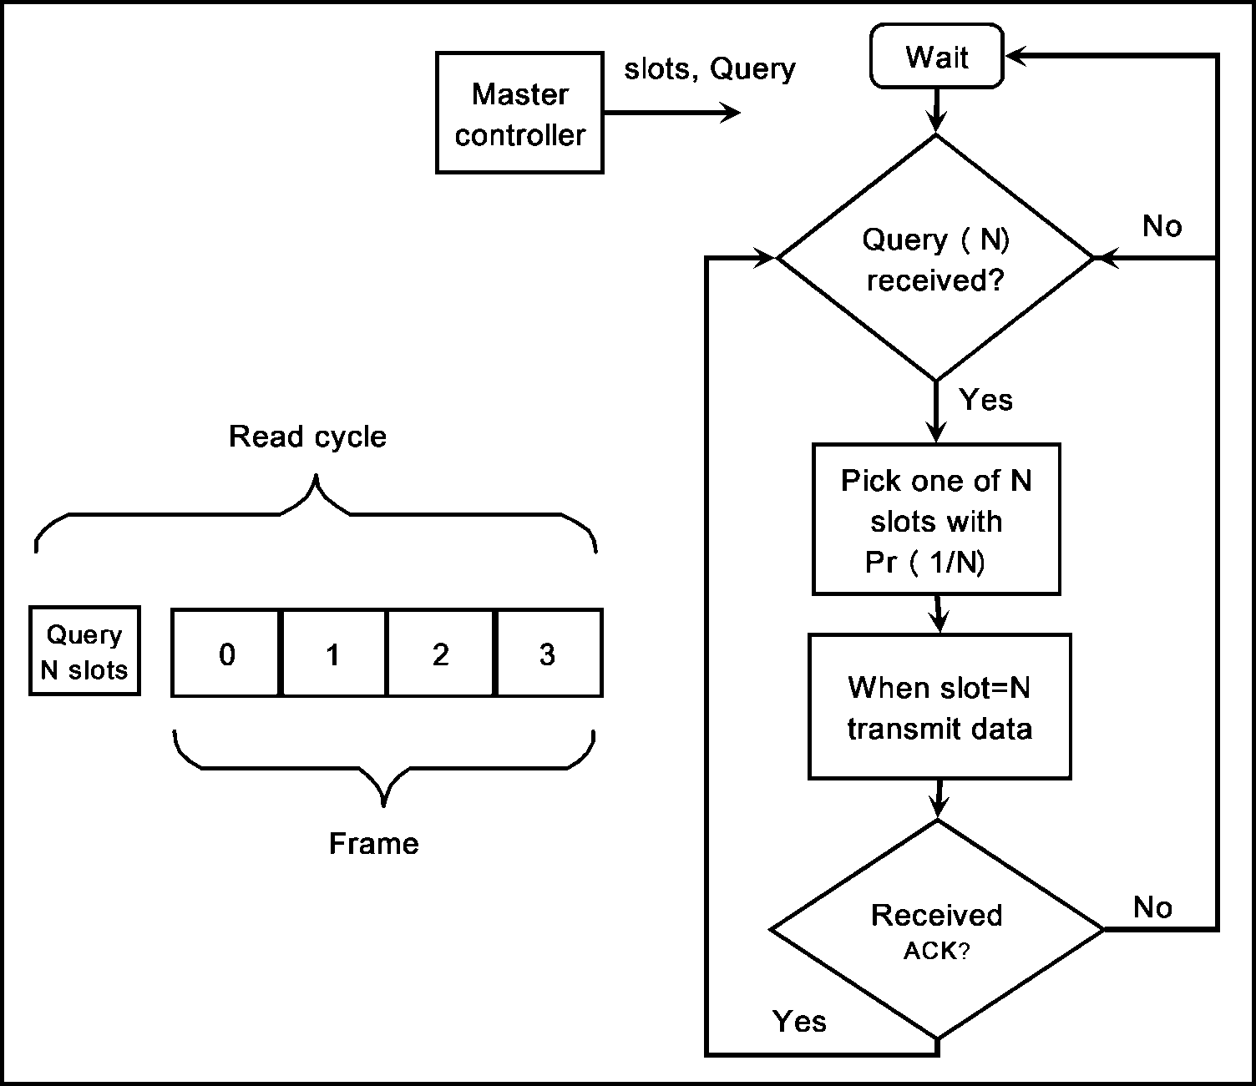
Framed slotted Aloha

Slide 21
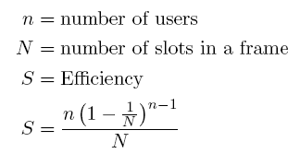
Framed slotted Aloha Efficiency

Slide 22
Deterministic Protocols
Deterministic protocols come under the classification of tree-based protocols where the tags are treated as nodes in a binary tree. The tags are identified based on their unique ID’s where the reader scans all the nodes of the tree in every round.
Most Tree based protocols are basically modified forms of Binary or Query Tree protocol.

Slide 23
Deterministic Protocols
In the first step, the reader performs a request to see whether there are transponders capable of processing the collision management according to the mode proposed by it.
All transponders which respond to this type of anti-collision process send, at a given time and in synchronism, a response to this request.
If there is at least one transponder in the magnetic field, the next step is to see whether one or more transponders are simultaneously present in the field and individually separate them from each other by their unique identity code.

Slide 24
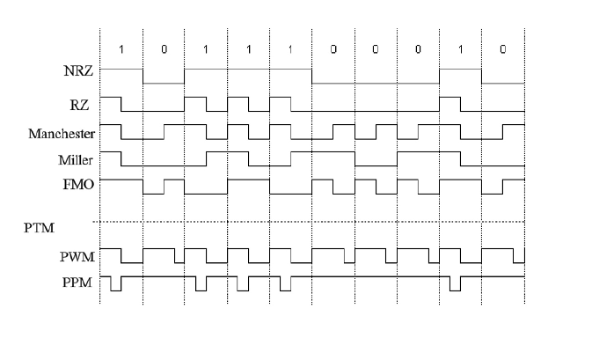
Data Coding

Slide 25
Data Coding
If several transponders respond simultaneously and synchronously, because of their unique identifier, a collision occurs at least at the bit level, and then it is necessary to detect the collision. In this case, the Manchester coding plays its role.
At the time of the request, the reader sends a parameter to the tags where the parameter indicates the response delay between the end of a request and the beginning of the expected response and facilitates the synchronization process.

Slide 26
Collision Detection
If more than one transponder transmits bits of different values simultaneously, the positive transitions cancel the negative transitions. If the reader detects no transition, it is understood that a collision has occurred between any two transponders who are simultaneously trying to access the channel.
The reader will detect the position of the collided bit by using efficient bit coding techniques; for example, using Manchester code the collided bit can be traced out.
In Manchester coding, positive transition is treated as logic ‘0’ and negative transition is considered as logic ‘1’. If there is no transition it means that an error has occurred.

Slide 27
Binary Search
Binary Search (BS) algorithm can solve the collisions by gradually decreasing the collided bits in transponder’s electronic serial number which is reciprocated by the transponder to the reader.
When a collision in a given bit is detected, the reader sends a request with the number of valid bits (the bits before the collision), which is immediately followed by a bit assigned to 1 ( or 0, this value is chosen by the designer of the reader).
Only those transponders which have the identifier part equal to the significant bits sent by the reader will be allowed to send the remaining bits of their identifiers.

Slide 28
Binary Search: Example
Assume that there are four transponders in the vicinity of the reader. At the beginning, the reader sends a request asking all the transponders that have serial numbers less or equal to 11111111 to respond.
Since 11111111 is the highest serial number, all transponders will answer to the reader in the starting iteration by sending their own serial numbers. Suppose if a collision is sensed in the received serial number at bit 0, bit 4 and bit 6.
It implies that there are eight (2³=8) or less transponders in the reading range. Bit 6 is the highest collided bit. This means that there is at least one transponder whose serial number value is less than 10111111.

Slide 29
Binary Search: Example
To restrict the number of answering transponders, the reader transmits a new request for transponders that meet the condition of (≤10111111) in the next round. Let’s say the received serial number has collisions at bit 0 and bit 4.
The same procedure will be repeated. The reader will request the transponders that have the serial numbers less than or equal 10101111 in the next round. Transponder 2 is only located in this iteration (3rd iteration). The reader then selects Transponder 2 and starts the communication.
By repeating these procedures, all transponders can be recognized by the reader

Slide 30
Binary Tree Protocol
Each tag has a counter -- initialized to zero.
A tag is also allowed to transmit when its counter is zero.
So, in the beginning there are collisions.
Reader transmits a feedback message to inform tags of collisions.
Upon collision, a tag randomly chooses a binary number that is added to its counter.
With this, at the next attempt, only those tags whose numbers are less than Max/2 transmit (set split into two sub-sets).
The process continues.

Slide 31
Binary Tree Protocol (cont)
When a collision occurs, a tag that is not involved in a collision, increases its counter by 1.
When a successful transmission is seen, tag decreases its counter by 1.
There is a frame structure -- all collisions resolved within the frame.
A tag that is recognized does not transmit until the ongoing frame is complete.

Slide 32
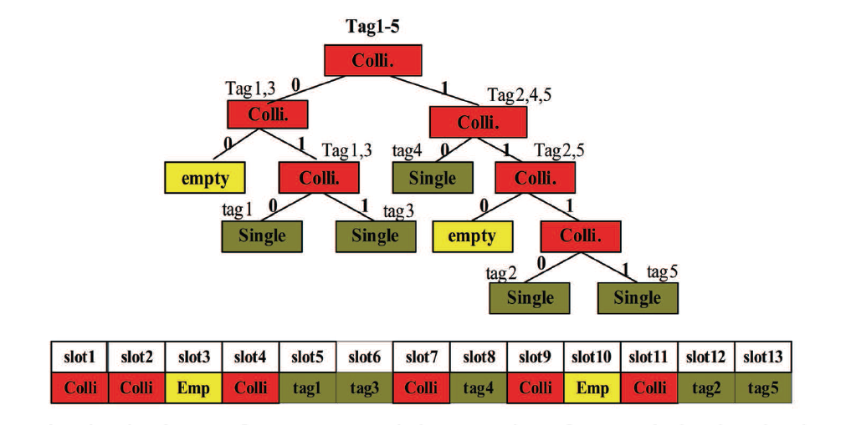
Example

Slide 33
Example
In tree-based RFID protocols, if a collision occurs in a timeslot, the colliding tags are randomly separated into two subgroups by independently selecting 0 or 1, until all tags are identified. The tags that select 0 transmit their IDs to a interrogator right away.
If a collision occurs again, the collided tags are split again by selecting 0 or 1. The tags that select 1 wait until all the tags that select 0 are successfully identified by the interrogator. And if all the tags that select 0 are resolved, the tags that select 1 send their IDs to the interrogator. This procedure is repeated until there is no further collision.
In the first timeslot, all tags select 0 or 1 randomly due to the collision. And tag 1 and 3 select 0. Both tags send their IDs at the next timeslot and are collided again.

Slide 34
Example
Tag 1 and 3 randomly select 1, no one select 0, then at the following timeslot, it is empty. At the fourth timeslot, it is collided again. Tag1 transmits its ID at the fifth timeslot successfully by selecting 0, and the interrogator can then read the tag 3 because of no collision at the next timeslot.
After the collision resolution of tag 1 and 3, tag2, 4 and 5 are collided at the seventh timeslot. Next, tag 4 selects 0 and tag 2and 5 select 1. Tag4 sends its ID at the eighth timeslot. Thus tag 2 and 5 send at the twelfth and thirteenth timeslot, respectively. Due to the no further collision, an interrogator finishes an identification process.

